Slide 1
CSE 4165: Web Programming
Lecture 2

Slide 2
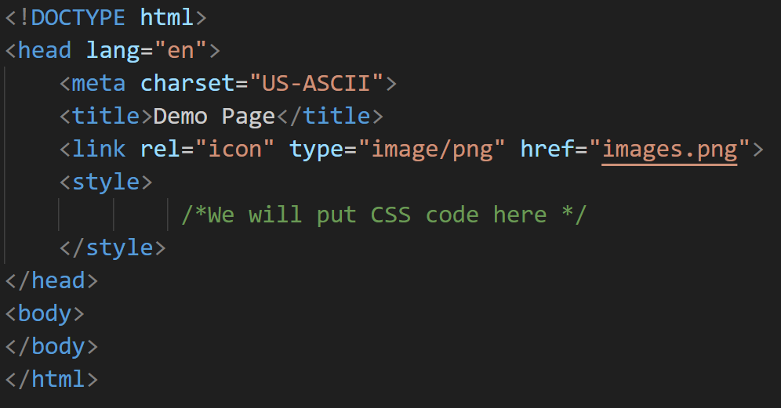
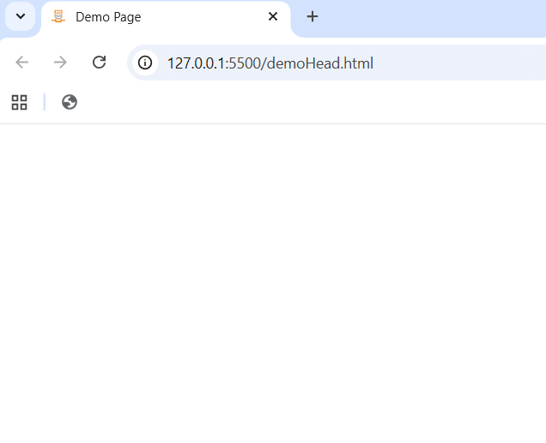
1. Basic Page Structure
We have already covered the basic page structure in lecture 1.
Let’s explore the contents in the head tag

Slide 3
1. Basic Page Structure

Slide 4
1. Basic Page Structure

Slide 5
1. Basic Page Structure

Slide 6
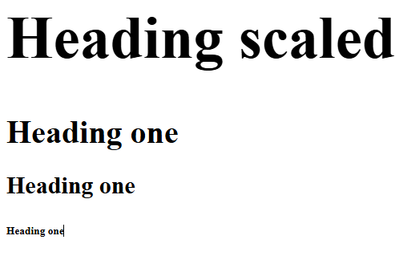
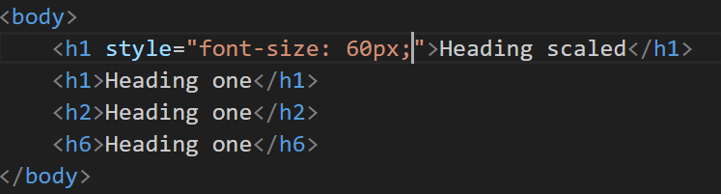
2. How big can a heading be (not header/head)
The style attribute used here with the h1 tag.
It provides easy way to integrate CSS code.
What kind of tag are the heading tags?

Slide 7
3. A bit about some of the block tags
Core points you should remember about block tags:
Newlines are present before and after a block tag.
Block elements stretch full width of the parent (exception table)
Width and heigh of block elements can be set
width, height
%, px
Padding can be set from all sides
Margin can be set from all sides

Slide 8
3. Inline Elements
Inline elements DO support:
left & right margin
left & right padding
background
text-related CSS
Inline elements DO NOT support:
width
height
top & bottom margin (no effect on layout)
top & bottom padding (visible but does NOT push elements away)

Slide 9
3. Inline Elements
Inline elements DO support:
left & right margin
left & right padding
background
text-related CSS
Inline elements DO NOT support:
width
height
top & bottom margin (no effect on layout)
top & bottom padding (visible but does NOT push elements away)
Note that both the types of tags support:
color – text color
background-color – self explanatory
font-size – size of textual content
text-align – center, left, right

Slide 10
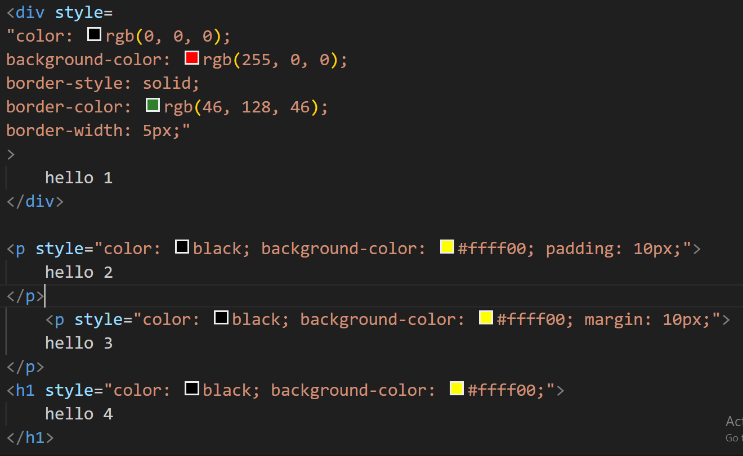
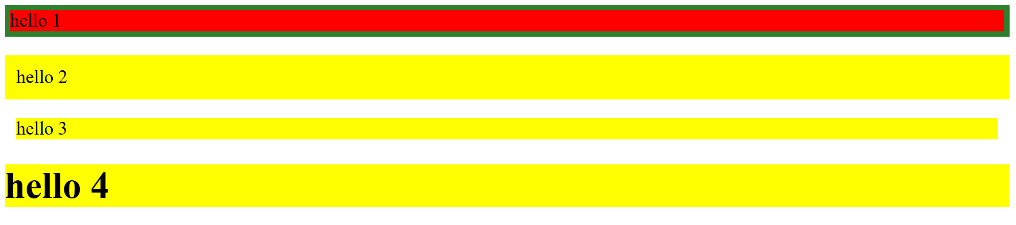
4. Let us apply CSS on some block elements

Slide 11
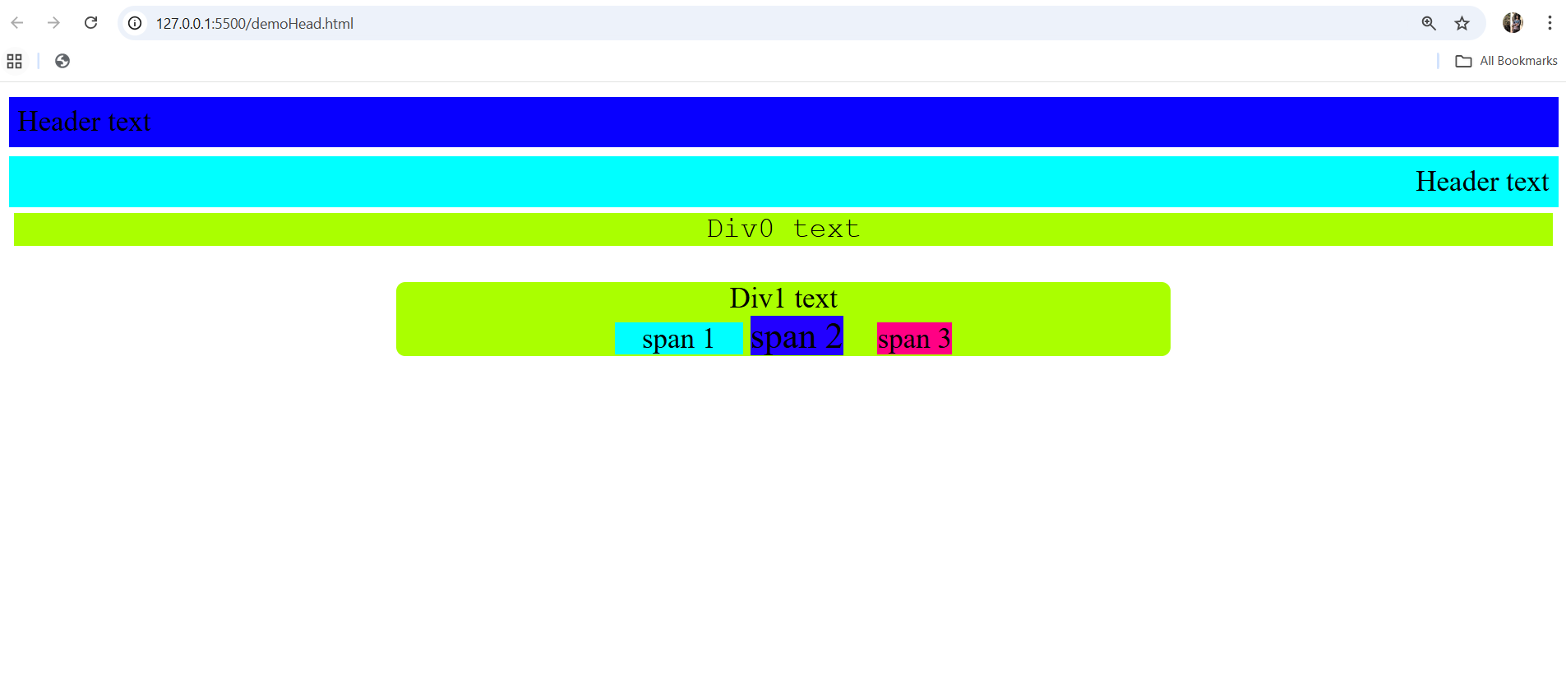
5. A small exercise
Use the tags and attributes you learned so far.
Do you think the aqua colored span (span 1) has a width and height?

Slide 12
6. Remember
BLOCK ELEMENTS
Can contain inline elements
Most can contain block elements
Some (like <p> and <h1>) can contain only inline
INLINE ELEMENTS
Can contain text
Can contain inline elements
Cannot contain block elements (try placing a div in a span)

Slide 13
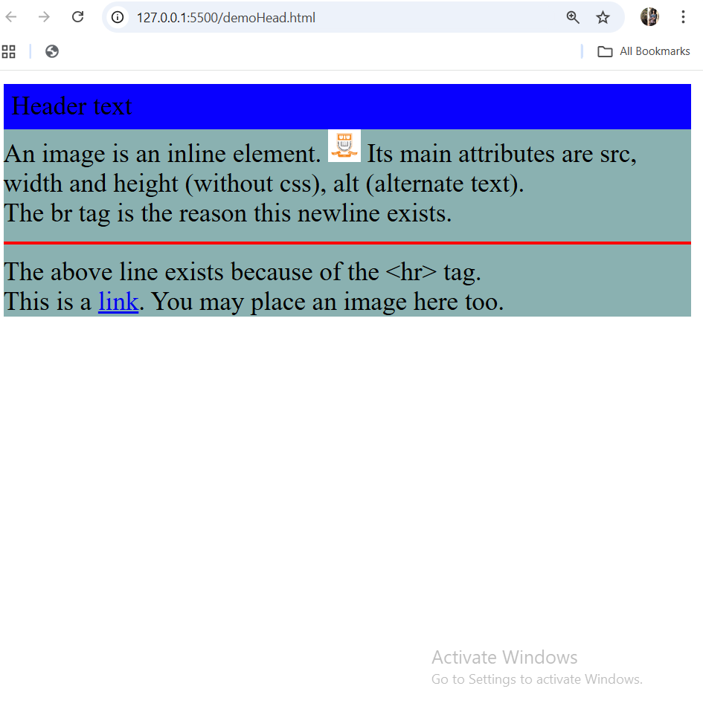
7. Four more tags <img>, <a>, <hr><br>
Which if the above 4 are inline/block?
Do it now before seeing the answer in the next page

Slide 14
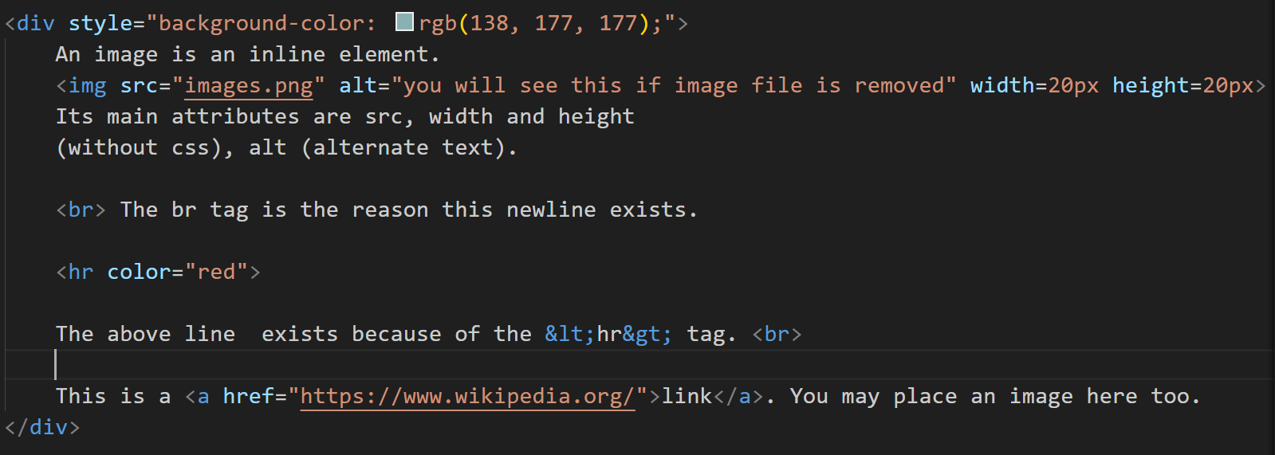
7. Four more tags <img>, <a>, <hr><br>

Slide 15
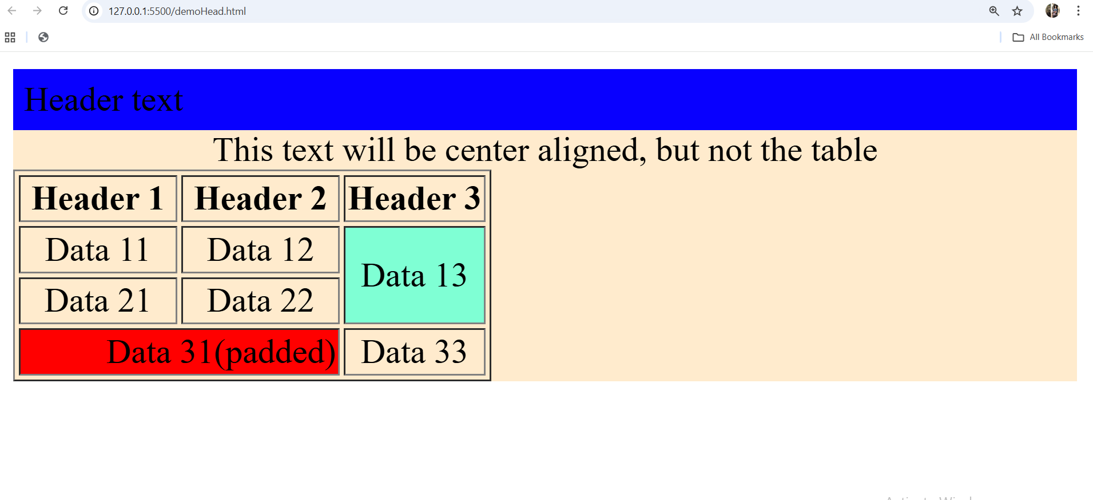
8. Is table a block tag or inline tag?
Let’s explore its properties a bit more!

Slide 16
8. Formatting Tags (test each with texts)
<b> - Bold text
<strong> - Important text
<i> - Italic text
<em> - Emphasized text
<mark> - Marked text
<small> - Smaller text
<del> - Deleted text
<ins> - Inserted text
<sub> - Subscript text
<sup> - Superscript text

Slide 17
Thank You

